Slide 1
Social Engineering Fundamentals

Slide 2
Lesson Overview
What is social engineering?
Common Tactics
Effective Techniques

Slide 3

What is a social engineering?

Slide 4

Human Manipulation
Notes:
Social engineering is a manipulation technique that exploits human error to gain private information, access, or valuables. Hacking human beings.

Slide 5

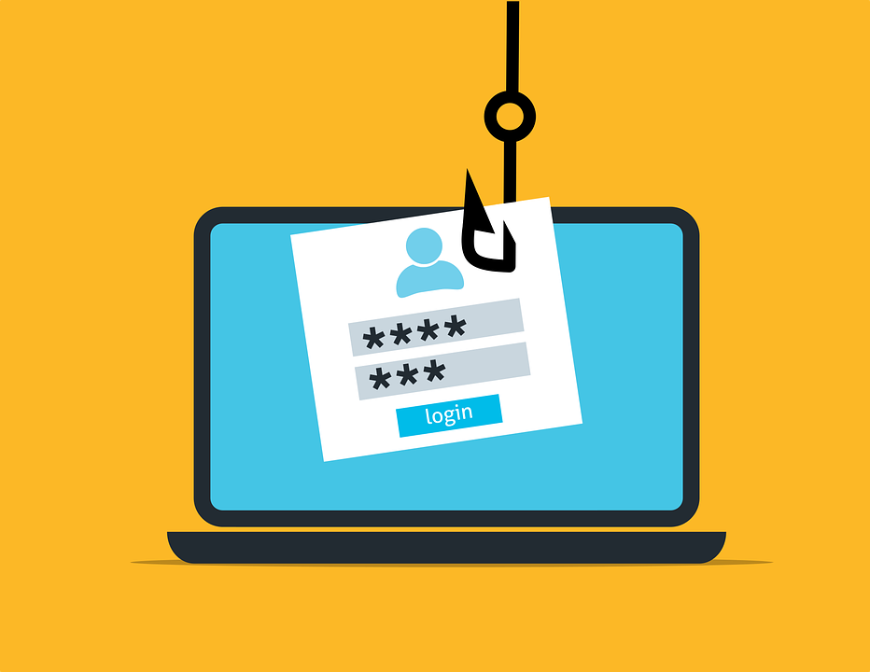
How is it used?
Notes:
Primarily: Gain access and Gather information

Slide 6
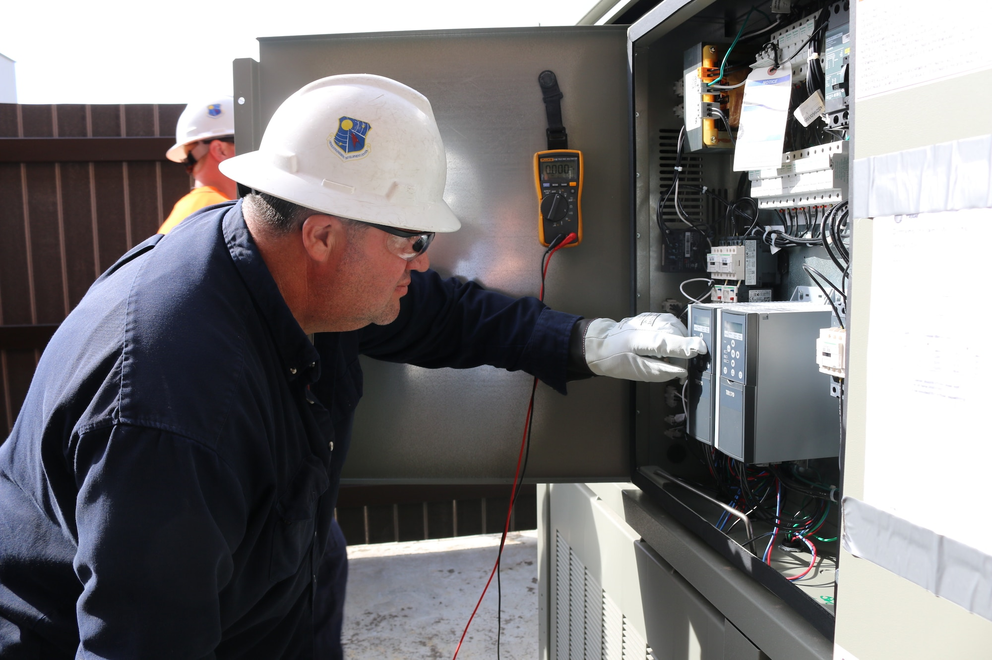

Manipulating Humans
Impersonation
Pretexting
Emotional Pull
Urgency
Free stuff
Blackmail/Extortion
Quid pro quo

Slide 7

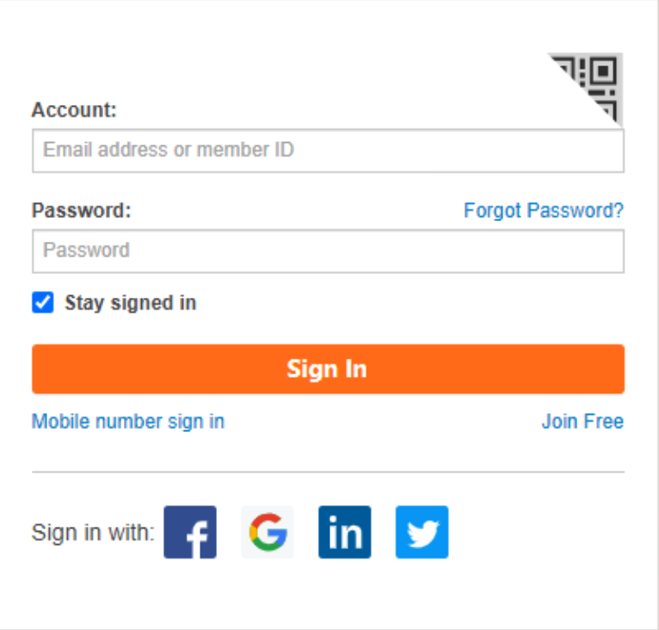


Common Tactics
Phishing*
Watering Hole
Baiting
Physical Access

Slide 8

Please Explain
Phishing - Malicious email
Reply with information
Click on links
Download files

Slide 9

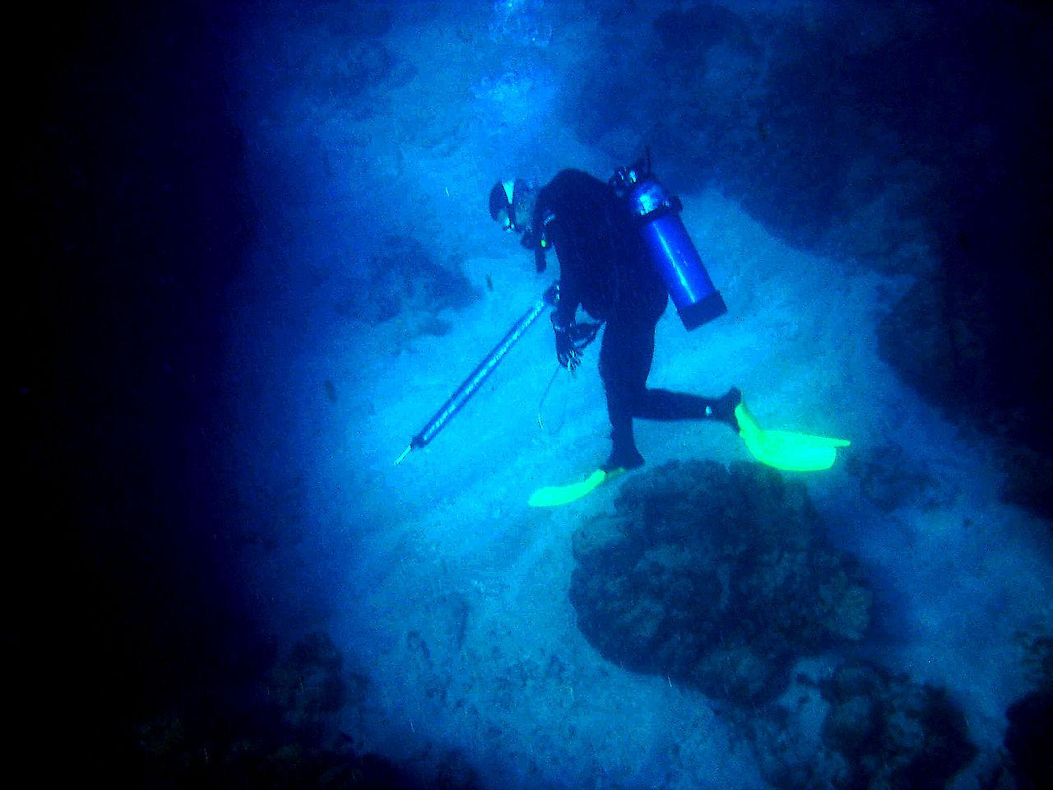
Please Explain
Spear Phishing - Targeted phishing
Whaling - Spear phishing of high-value individuals (C-suite, Board Members)
Smishing - Like phishing, but through SMS messaging
Vishing - Like phishing, but through voice calls

Slide 10
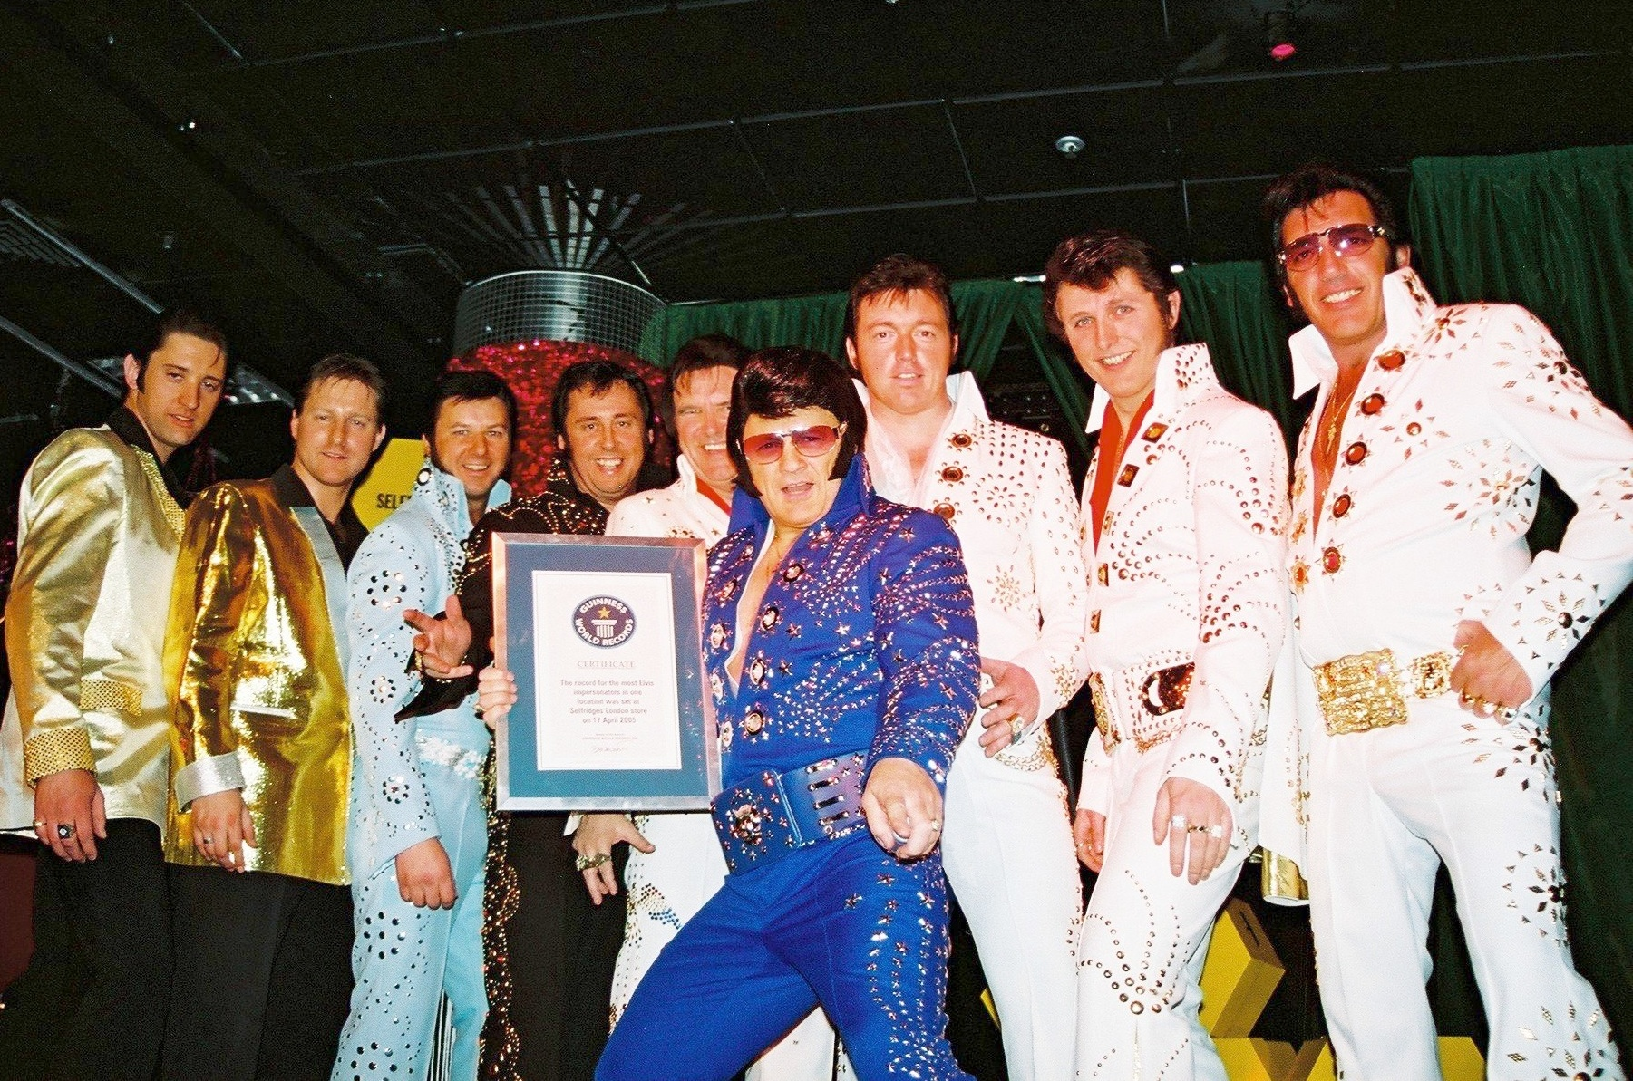
Who Would Fall For That?
Pharming - Redirecting web traffic maliciously
Watering Hole - Use a trusted site against you
BEC - Business Email Compromise
Impersonation/Spoofing - Additional tactic

Slide 11
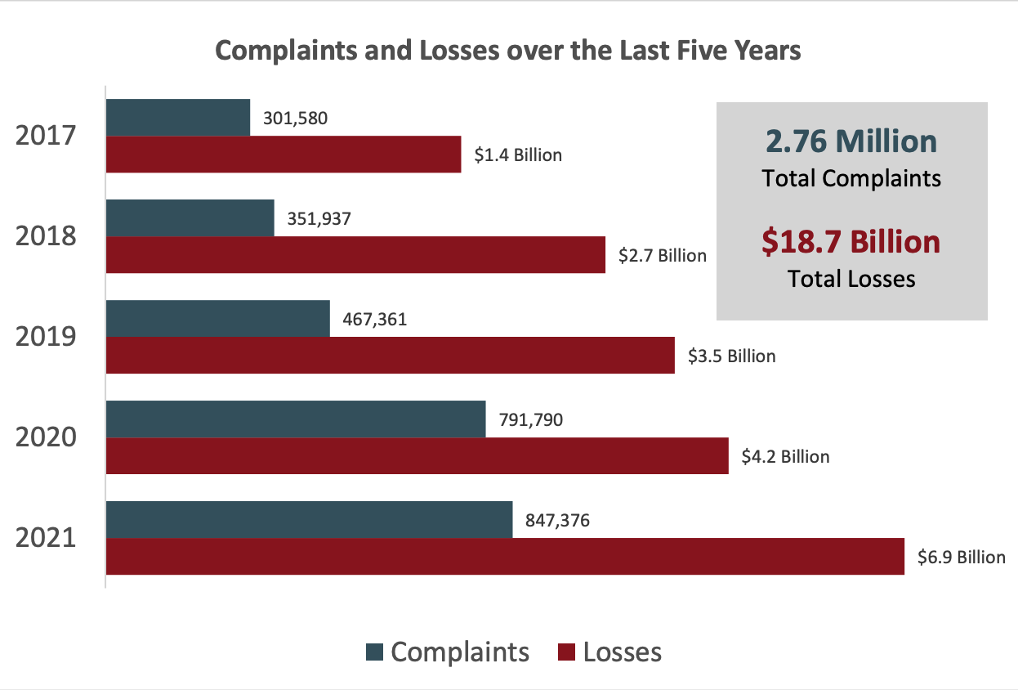
Effective
Notes:
https://www.ic3.gov/Media/PDF/AnnualReport/2021_IC3Report.pdf
FBI report on cyber crime

Slide 12
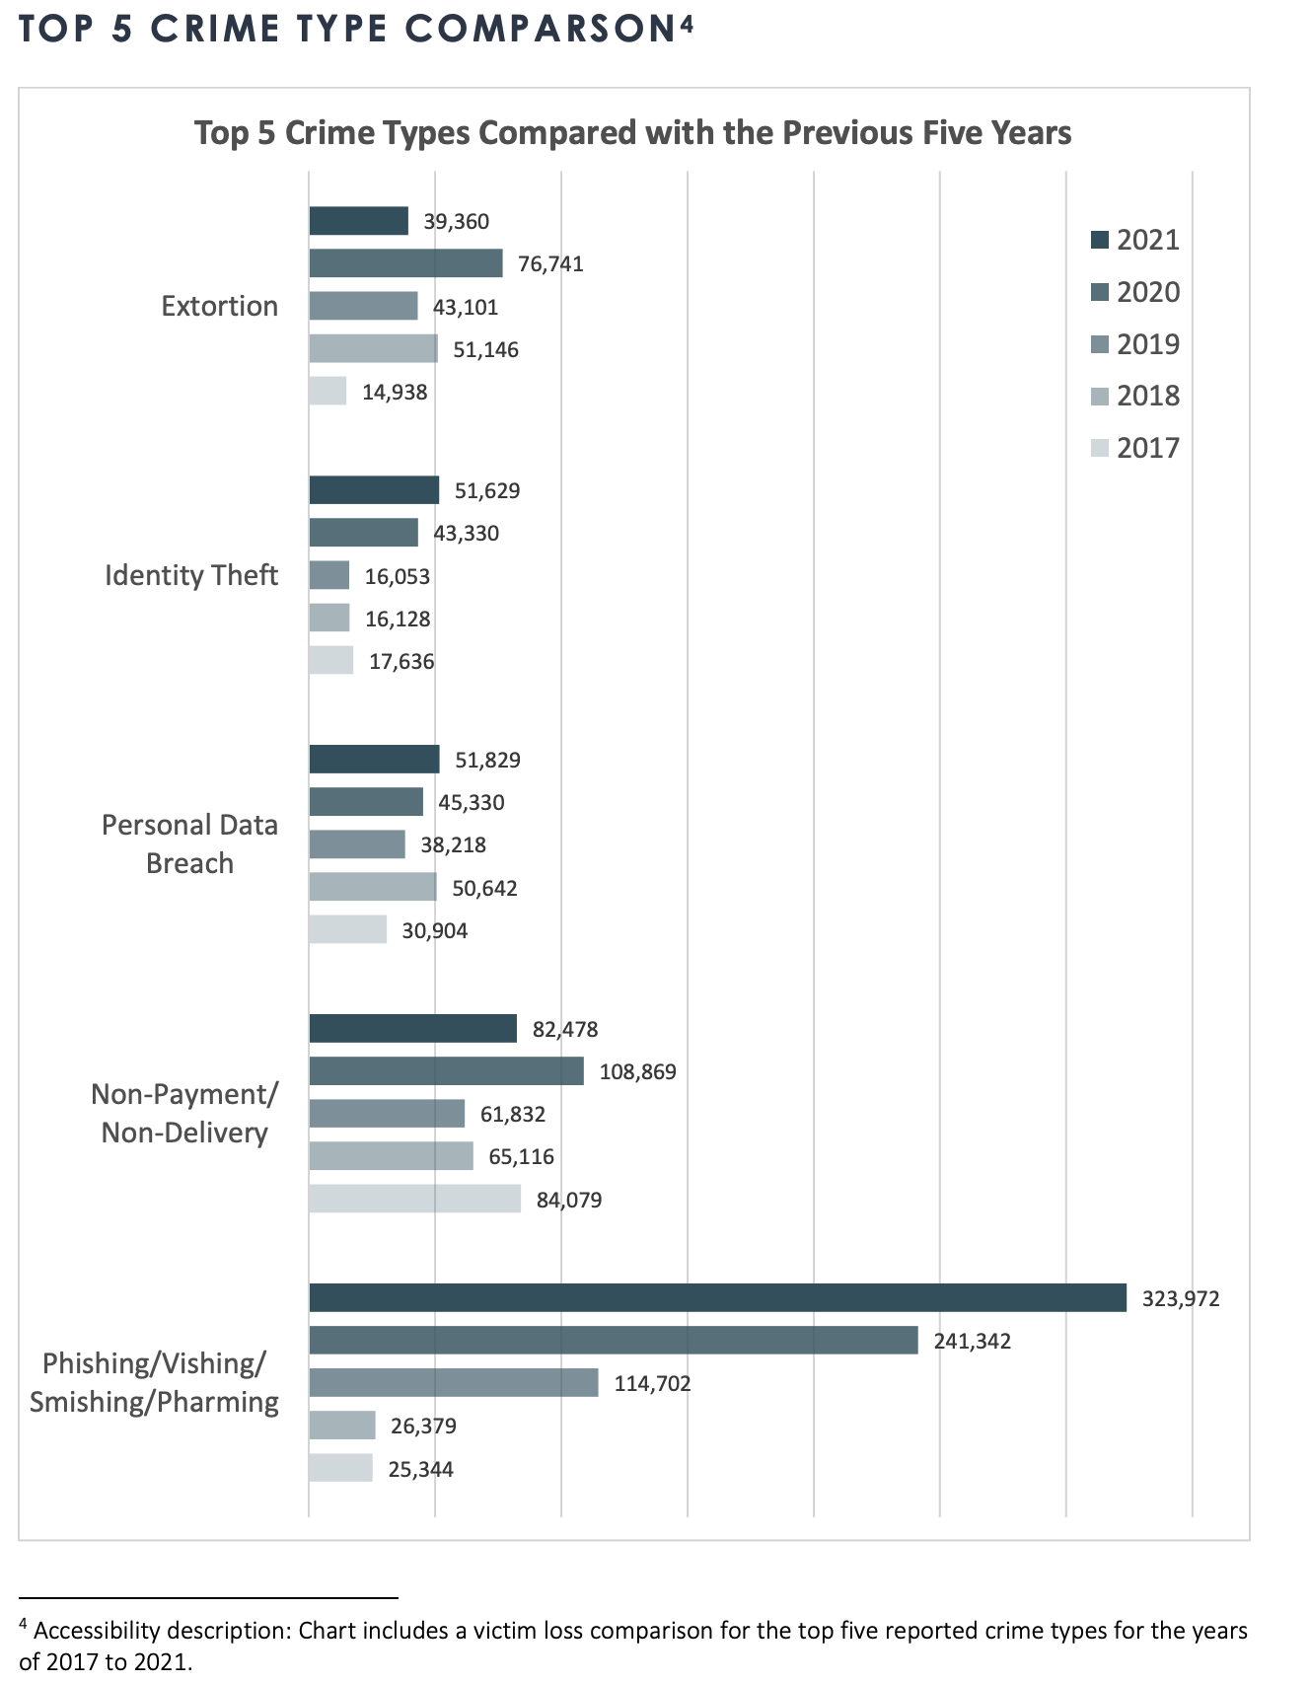
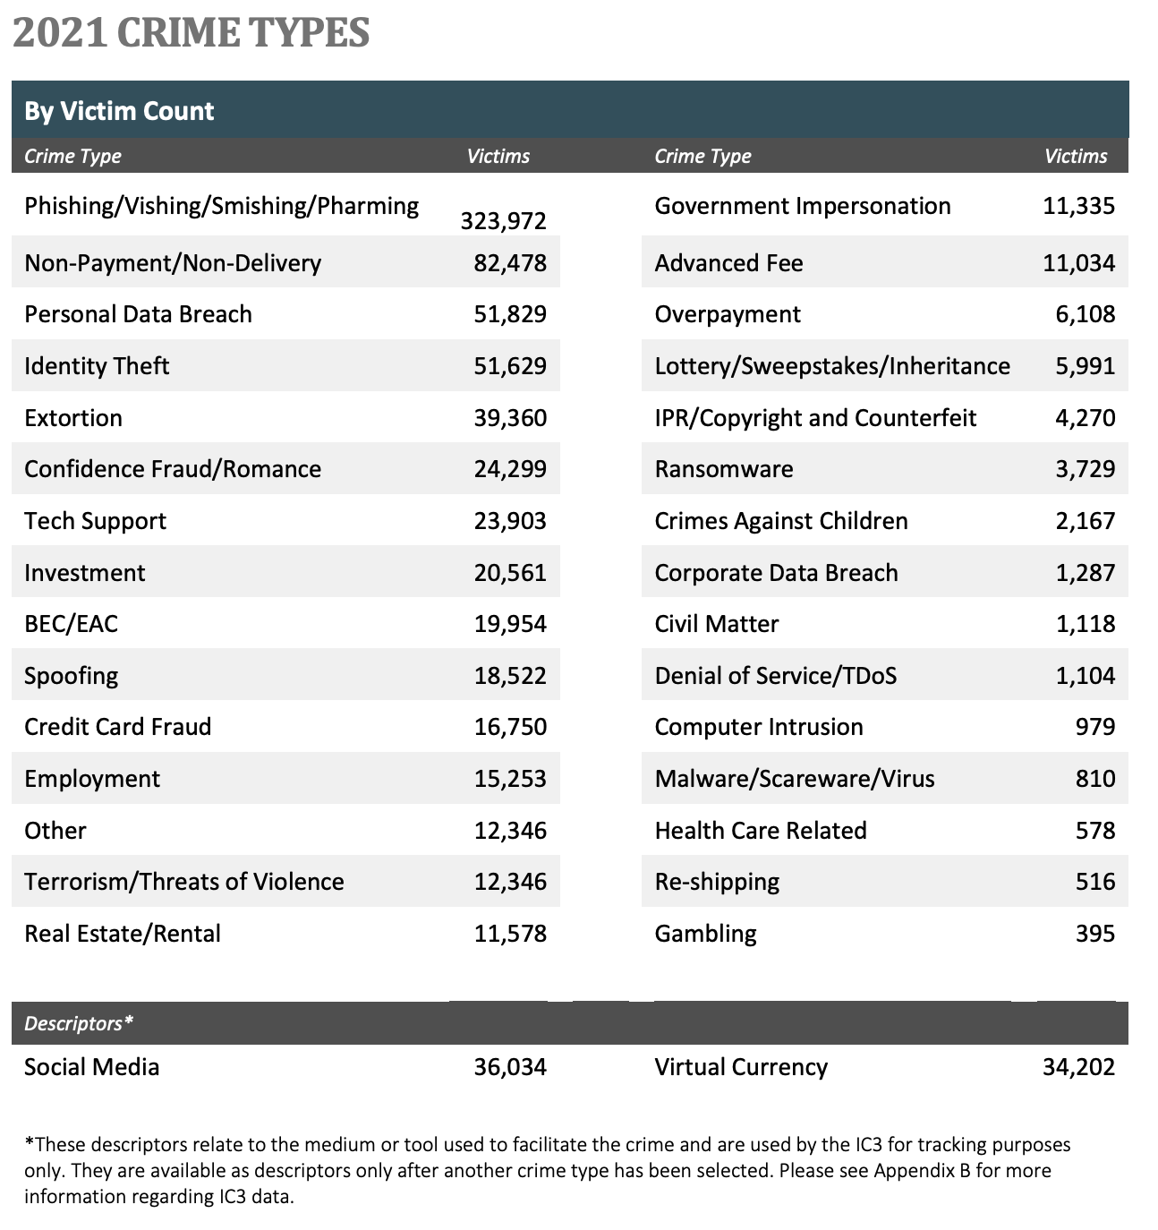
Effective
Notes:
https://www.ic3.gov/Media/PDF/AnnualReport/2021_IC3Report.pdf
FBI report on cyber crime

Slide 13
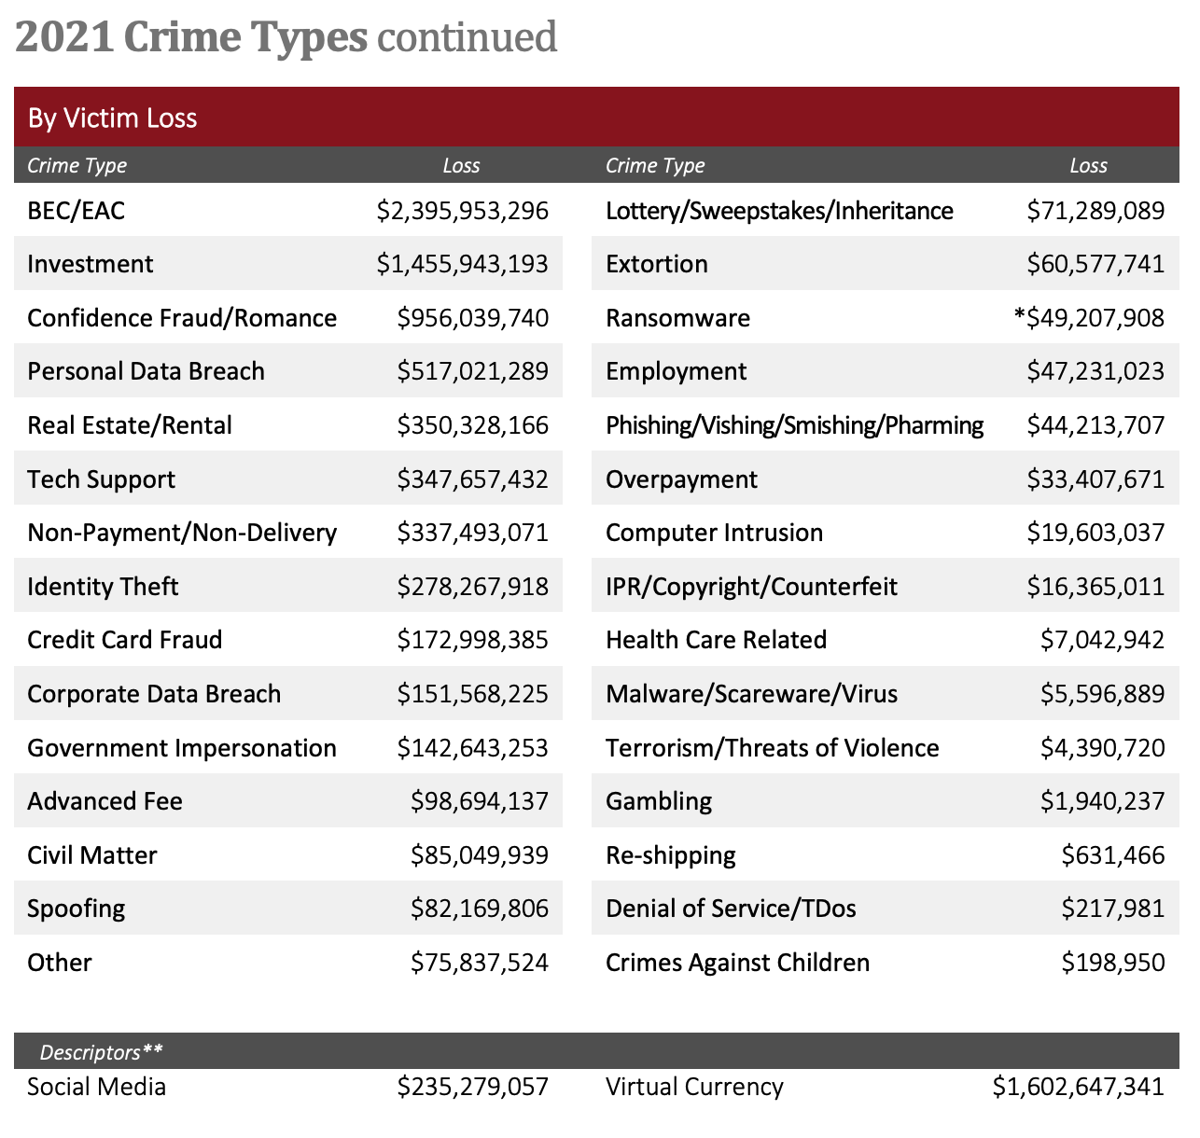
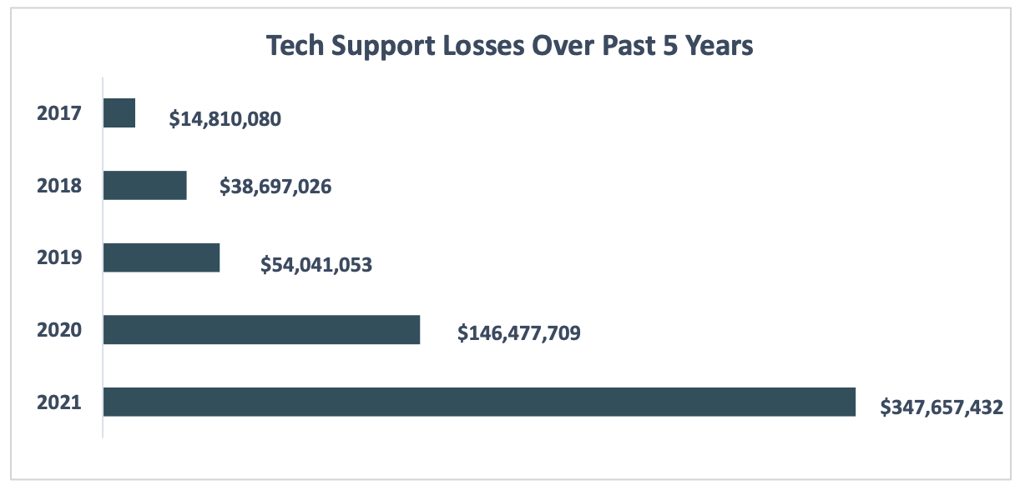
Effective
Notes:
https://www.ic3.gov/Media/PDF/AnnualReport/2021_IC3Report.pdf
FBI report on cyber crime

Slide 14
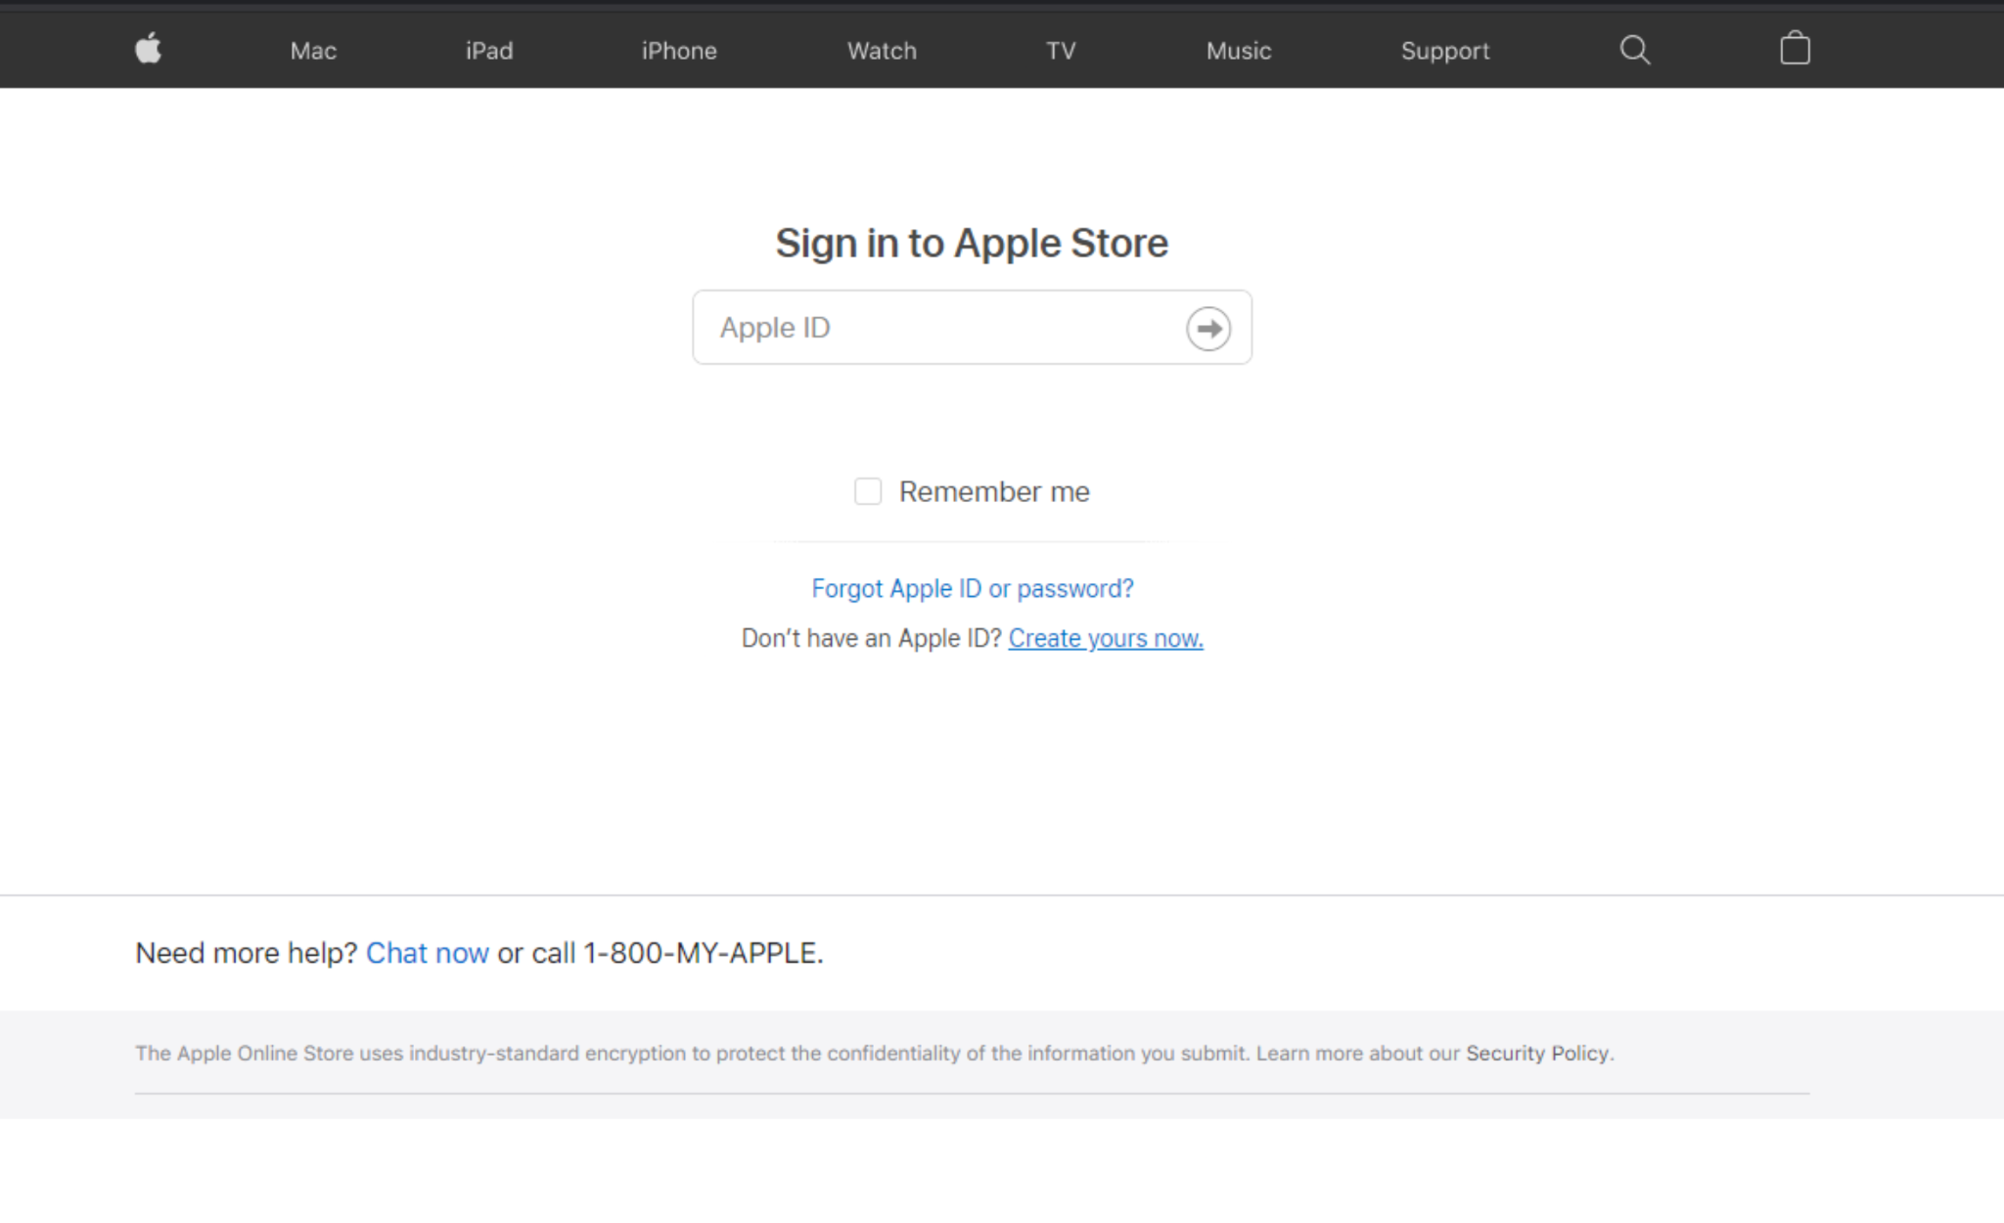
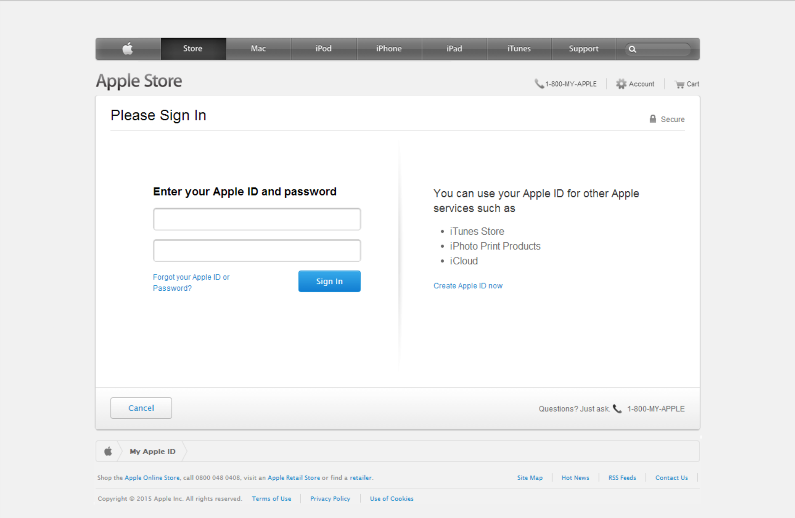
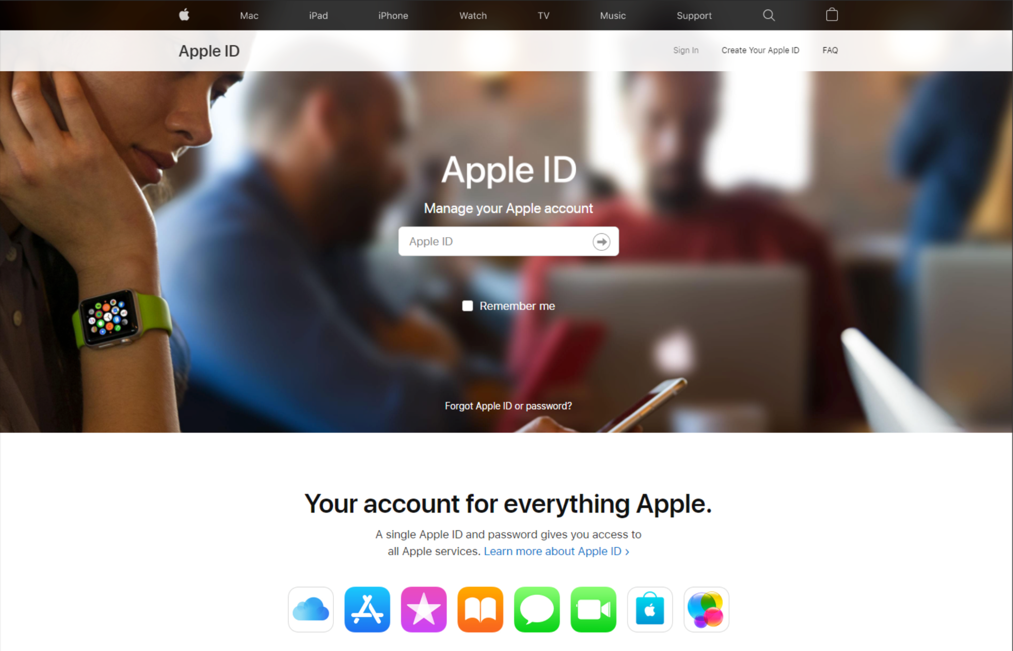
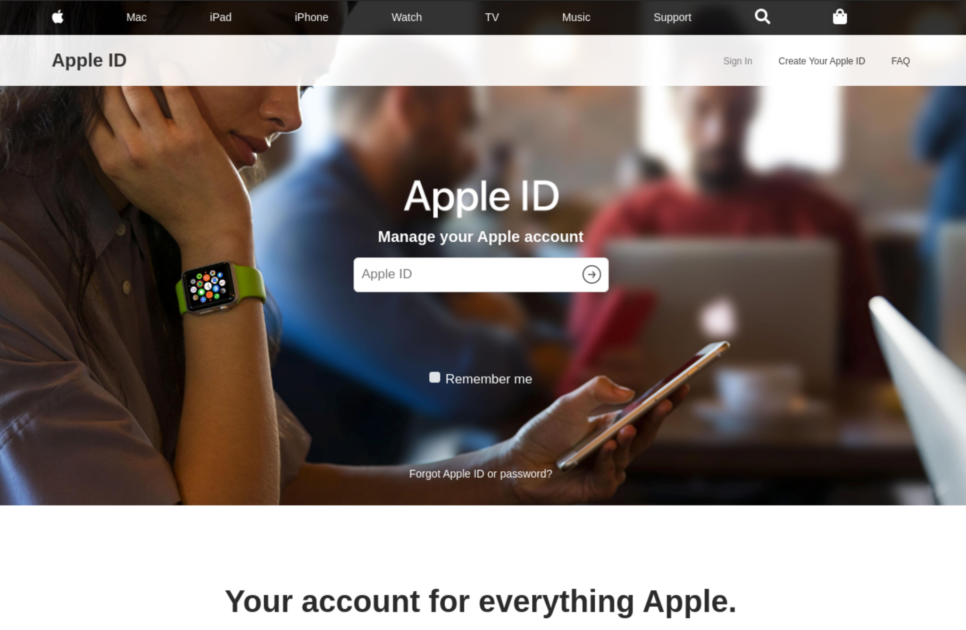
Very Effective
Notes:
Ironscales login pages comparison
https://secure4.store.apple.com/shop/signIn?ssi=1AAABf8KQtWEgHbh3XlGLZi1Ag_Rc2rJIGrq3F3jRuUXJ4LbofuNJZcUAAAA-aHR0cHM6Ly93d3cuYXBwbGUuY29tL3Nob3AvYmFnfGh0dHBzOi8vd3d3LmFwcGxlLmNvbS9zaG9wL2JhZ3wAAgEADaoizX6rkGRiYYrRworW5wRYI6JKphTJmV5oQ_Xj-A

Slide 15
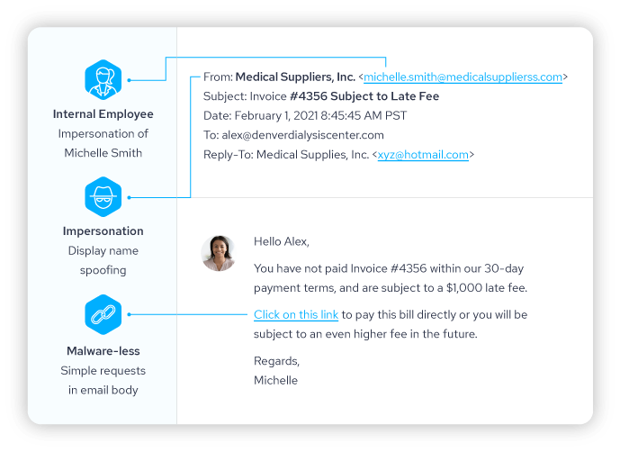
Very Effective
Notes:
Ironscales image - https://ironscales.com/resources/learn/what-is-email-spoofing/
https://www.verizon.com/business/resources/reports/2019-data-breach-investigations-report.pdf

Slide 16



Super Effective
USB Autorun

Slide 17



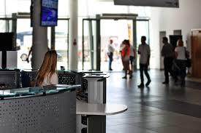
Super Effective
Physical Access

Slide 18

What does that have to do with cybersecurity?

Slide 19
Stop the Attack
User Awareness and Training
Security Controls
Defense in Depth

Slide 20
Isn’t this a pentesting course?

